Slide 1
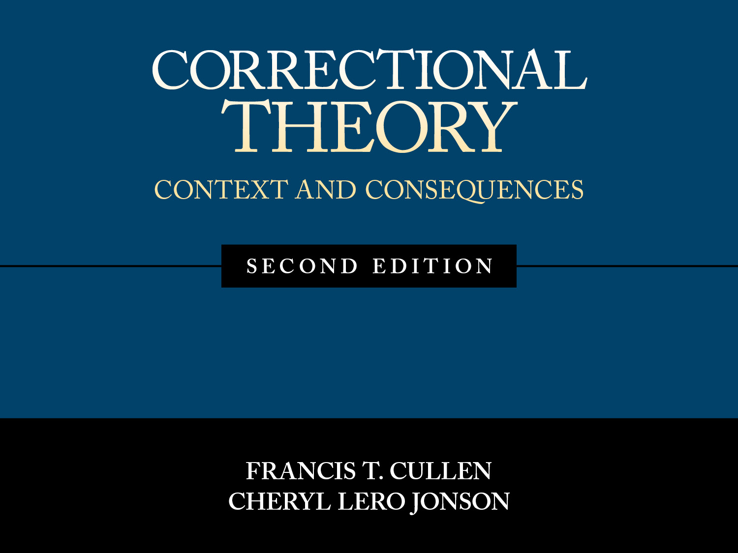
Chapter 1
From Theory to Policy: Evidence-Based Corrections

Slide 2
Official Statistics
More than 1.5 million offenders are imprisoned in state and federal institutions
When inmates in jails and other custodial facilities (e.g., juvenile institutions) are included in the count, the nation’s incarcerated population surpasses 2.2 million
There are approximately 3.9 million offenders on probation and more than 850,000 people on parole
Taken together, nearly 7 million Americans are under the supervision of the correctional system

Slide 3
The Future of Incarceration
The United States clearly has grown remarkably fond of a massive correctional system that is “addicted to incarceration” (Pratt, 2009)
Signs exist the United States is trying to kick the imprisonment habit
But other Western industrial nations exercise more restraint in locking up their citizens, both in terms of how many and for how long

Slide 4
Why Are So Many Incarcerated?
The simple answer is that they have committed crimes and been convicted, and thus some response by the government is required
However, there are two problems with this answer:
It suggests that the amount of crime and the amount of corrections in a nation are tightly connected
Within the United States, correctional populations do not rise and fall as crime rates rise and fall
It begs the larger question of what purpose is served by intervening in the lives of offenders
What do we hope to accomplish?
What theories drive the larger purpose of incarceration?

Slide 5
The Role of Theory
Theories matter because they affect correctional policy
Competing visions have been set forth of what corrections should be about
Rival theories of corrections have three components:
There is a statement of the purpose or goal of corrections
Tend to emphasize either restraining and inflicting pain on offenders or helping and reforming offenders
A punishment response versus a social welfare response
Each theory has an implicit or explicit blueprint for how the correctional system should be arranged, including policies, practices, and organizational structure
Theories also breed conflict because each one demands that the correctional system be organized in a different way
They each make a claim of effectiveness
Advocates assert not only that a theory’s core goal is moral but also that their theory can be implemented effectively

Slide 6
The Role of Theory in Evidence-Based Corrections
Evidence-based corrections
Critical in discerning what works and what does not work
Data, not opinions, should play the central role in guiding allegiance to any given correctional theory and the correctional system it proposes
Theories are not autonomous entities that exist in some virtual reality above the world they seek to guide
They are produced by and believed by humans who live in particular socio-historical times
Social context matters
What people experience shapes how they see the world, which in turn makes them more receptive to certain correctional theories than to others
CONTEXT → THEORY → POLICY

Slide 7
The Role of Evidence-Based Corrections
A huge problem in corrections is that many policies and practices have been based more on common sense rooted in individuals’ experiences than on hard empirical evidence
This failure to consult the evidence has led to correctional interventions that either are ineffective or iatrogenic–a “cure” that actually makes the patient, in this case the offender, worse off
Correctional quackery (using interventions not based on the scientific evidence) is widespread and its eradication is a key challenge for those hoping to make American corrections better for offenders and better for public safety

Slide 8
Core Themes of the Book
Correctional theories identify what the purpose of the correctional system should be and what policies should be implemented
Historically, the popularity of competing correctional theories has been shaped by the prevailing social context
Theories should be judged in large part on whether the policies they suggest achieve what they promise
They key to knowing what does and does not work—to knowing what theories should be embraced—is to look at the data
Corrections should be evidence-based

Slide 9
Seven Theories of Corrections
Retribution or Just Deserts
Deterrence
Incapacitation
Restorative Justice
Rehabilitation
Reentry
Early Intervention

Slide 10
1. Retribution or Just Deserts
At the core of this theory is to mandate to pay an offender back for his or her wrongdoing
This attempt to “get even” is sometimes called “retribution” and sometimes called “just deserts”
Conservatives wish to ensure that offenders feel the pain they have caused, they thus seek retribution
Achieved only when harsh punishments—especially lengthy prison terms—have been imposed
Liberals wish to make sure that offenders suffer no more than the pain they have caused; they want to see justice done by only that which is truly deserved
Achieved through more moderate punishments and shorter prison sentences
Those in both political camps embrace the idea that the core purpose of the correctional system is to balance the scales of justice

Slide 11
1. Retribution or Just Deserts
Offenders are punished as an end in and of itself—to achieve justice
Such pain or punishment is seen as warranted or “deserved” because the offender is assumed to have used his or her “free will” in deciding to break the law
This theory is non-utilitarian (seeks to be an end in an of itself)
Theories that are utilitarian seek to sanction offenders not simply to sanction them, but for some other purpose (purpose is most often to reduce crime)
This theory is based mainly on values—on the principle that people who harm others deserve to be harmed equally in response
This theory does NOT make claims that can be evaluated with evidence—not about reducing crime but about other things

Slide 12
2. Deterrence
Proposes that offenders should be punished so that they will be taught that “crime does not pay” and thus will not return to crime
Assumes that offenders are rational
Accordingly, efforts to increase the cost of crime—usually through more certain and severe penalties—will cause offenders to choose to “go straight” out of fear that future criminality will prove too painful
Specific deterrence: Offenders will refrain from reoffending so as to avoid the cost of the criminal sanction
General deterrence: People might decide to commit or not commit a crime depending on what they see happens to other people who break the law

Slide 13
2. Deterrence
Deterrence theory advocates oppose discretion
Advocates assume offenders exercise rational choice when breaking the law by assessing the potential costs of committing a crime, such as going to prison, versus the potential benefits, such as stealing money or a computer
Good
Bad

Slide 14
2. Deterrence
If people do consciously weigh costs and benefits then two things follow:
In many criminal situations, the benefits of crime are staring offenders in the face
Gratifications tend to be immediate and often easily attained
People will exercise self-control only when a little accountant pops up in their heads to say: →→→→
The critical issue thus becomes whether this little accountant thinks the crime—stealing the computer— will lead to an arrest and knows what punishment a subsequent conviction will actually bring
Every time judges and parole boards exercise discretion, they claim, the cost of punishment is made either less certain or less severe

Slide 15
2. Deterrence
Provides the basis for a particular kinds of correctional system:
Punish the crime, not the criminal
Deterrence is a utilitarian theory (all about crime control)
Punishments are to be fixed tightly to specific crimes so that offenders will soon learn that the state means business—no wiggle room allowed as the sentences served are to be determinate, not indefinite or indeterminate
Once the sentence is imposed, no early release

Slide 16
3. Incapacitation
No assumption is made about offenders and why they commit their crimes
Criminals are likened to wild, predatory animals, whose essential natures are given and are not going to change
We do not really care why they got that way, and we should have no illusions that they can be reformed
Explicit utilitarian goal is to reduce crime by caging or incarcerating offenders
The amount of crime saved—that does not occur—because an offender is in prison and not in the community is called the incapacitation effect
When prison is used to lock up everyone who has committed a certain crime (e.g., all gun offenders), this is called collective incapacitation
When an effort is made to predict who will be high-rate offenders and lock up only them, this is called selective incapacitation

Slide 17
3. Incapacitation
If dangerous offender are behind bars, then they are not in my community—or any community—committing crime
Incapacitation theory confronts two daunting difficulties:
Its main correctional advice is to build more and more cages to house more and more offenders
There is an immense opportunity cost (what you forgo—what you do not do—when you spend money on one thing rather than on another) to prisons
Money devoted to prisons cannot be devoted to treatment programs or to creating early intervention programs
The theory of incapacitation has nothing useful to say about what to do with the more than 620,000 offenders who return to society each year—most after serving about two to three years behind bars

Slide 18
4. Restorative Justice
The goal is for all harms to be rectified and the injured parties to be restored
Offenders must restore the victims and community they harmed
This might be done by apologizing and by providing restitution to the victim and doing service for the community
In exchange, however, the offender is forgiven by the victim and accepted back into the community as a full-fledged member
Restorative justice is both non-utilitarian and utilitarian
Non-utilitarian: There is an overriding concern for achieving justice in and of itself
The goal is to motivate offenders to admit their wrongdoing, apologize to victims, and take steps to compensate victims and the community for the harms suffered
Utilitarian: It claims that its approach of harm reduction is more likely to lower recidivism than the typical correctional response
Advocates wish to take offenders out of the traditional justice system, using prisons only as a sanction of last resort

Slide 19
4. Restorative Justice
Appealing theory, but also a good bit that is potentially problematic
One difficulty is how to implement restorative justice in a nation that has more than 2.2 million offenders incarcerated—a number that may well decline but is unlikely any time soon to head south of 2 million
Restorative justice is antiscientific
Its advocates believe that research on what works to make rehabilitation programs more or less effective is irrelevant
Convinced that the key to reducing crime is the good faith efforts of non-professionals to construct a web of supportive relationships around the wayward that makes reoffending unlikely

Slide 20
5. Rehabilitation
The goal is to intervene so as to change those factors that are causing offenders to break the law
Utilitarian theory
The assumption is made that crime is determined by factors (e.g., antisocial attitudes, bad companions, dysfunctional family life)
Unless these criminogenic risks are targeted for change, then crime will continue
Thus, crime is saved—recidivism is reduced—to the extent that correctional interventions succeed in altering the factors within or very close to offenders that move them to commit crimes

Slide 21
5. Rehabilitation
Thus, rehabilitation theory predicts that if offenders are incapacitated—simply warehoused without treatment—then they will leave prison no better off, and worse off if they have been exposed to criminogenic risk factors while behind bars
The theory also predicts that deterrence-based policies will not be very effective in preventing reoffending because they are based on a limited, if not incorrect, theory of crime (crime is simply a rational choice)

Slide 22
5. Rehabilitation
Rehabilitation has its own challenges to overcome if it is to claim the mantle as the guiding theory of corrections
It is not easy to change people who do not want to change and may have spent their whole lives developing into hard-core criminals
Further, saving people within correctional agencies is difficult
Prisons are hardly ideal therapeutic settings, and many correctional workers lack the professional orientation, therapeutic expertise, and organizational resources to deliver effective interventions

Slide 23
6. Reentry
The main difficulty of mass imprisonment is that more than 1.5 million inmates are housed on any given day in state and federal prisons:
And when you send a lot of people to prison, a lot of people come out of prison
In the 1960s and 1970s, calls were made to “reintegrate” inmates returning to the community
Yet this concern was muted and unorganized
The number of released inmates from state and federal prisons first topped 200,000 in 1983 and 300,000 in 1988
New records were set in rather quick order: 400,000 was reached just two years later in 1990; 500,000 was surpassed in 1997; and 600,000 was attained in 2000
“iron law of imprisonment: they all come back”
--Jeremy Travis (2005)

Slide 24
6. Reentry
By the time Travis published his book in 2005 (But They All Come Back), more than 700,000 inmates were being released annually—a figure that rose to a high mark of 729,749 in 2009
Along with Joan Petersilia (2003), who wrote a similar book around the same time (called When Prisoners Come Home), his message was now difficult to ignore:
We have to do something about the horde of inmates returning to our communities who then often are arrested and sent back to prison (Clear, 2007)
The number of released inmates has fallen more than 100,000 inmates, down to 623,337 in 2013
But this is still a large population

Slide 25
6. Reentry
But there was one more clever thing that Travis—and Petersilia—both did: They used the word reentry
The word reentry captured the reality that inmates are not simply being “released” or “returning” to society
Rather, they undergo an inevitable experience of having to leave prison and reenter a social life that they have been kept away from for a lengthy period
This theory is not the same as other theories that apply to virtually the entire correctional process, because it is focused only one component of this system
Involves rehabilitation
Utilitarian theory

Slide 26
6. Reentry
Definition:
Reentry is defined as the transition of offenders from an institution into the community, typically under some form of correctional supervision
Reentry is a planned correctional intervention designed to facilitate an inmate’s return to society so as to prevent further recidivism
Programs can be undertaken in one of three phases (or across all three phases):
During incarceration
During a period that spans or immediately follows incarceration (e.g., a halfway house)
Fully after incarceration

Slide 27
6. Reentry
Involves two central components intended to save released inmates from a life in crime:
Correctional component
Covers the actions taken by officials to reduce the likelihood of recidivism
Includes treatment programs aimed at reducing criminal propensity
Reintegration component
This involves taking positive steps to help released inmates assume core social roles (e.g., employment, family) and to acquire material support to survive in the “real world” (e.g., housing, medical services)
It also involves trying to remove the negative “collateral consequences” that restrict reintegration into society
Often written into federal and state laws, collateral consequences are the rights (e.g., voting) and privileges (e.g., access to certain occupations) that offenders lose as a result of a criminal conviction, especially a prison sentence

Slide 28
7. Early Intervention
Early intervention involves placing children at risk for a criminal future into programs early in life so as to prevent them from developing into juvenile or adult criminals
David Olds (2007)
Ingeniously came up with the idea of sending experienced nurses to visit at-risk expectant mothers both during pregnancy (to encourage healthy behavior) and after pregnancy (to help the mothers in parenting skills)
This program has proven successful in achieving healthy pregnancies and thus in saving children from struggling with crime-inducing deficits that can be traced to the womb

Slide 29
7. Early Intervention
Early intervention is not really a correctional theory in that it does not carry advice on how to organize the correctional system
Focuses on what should be done with people before they have broken the law
Utilitarian theory
Similar to rehabilitation, early intervention is based on the criminological reality that individuals with certain traits and exposed to certain social conditions develop propensities to engage in crime
If these propensities are diagnosed and cured through some treatment will the individual be diverted from crime

Slide 30
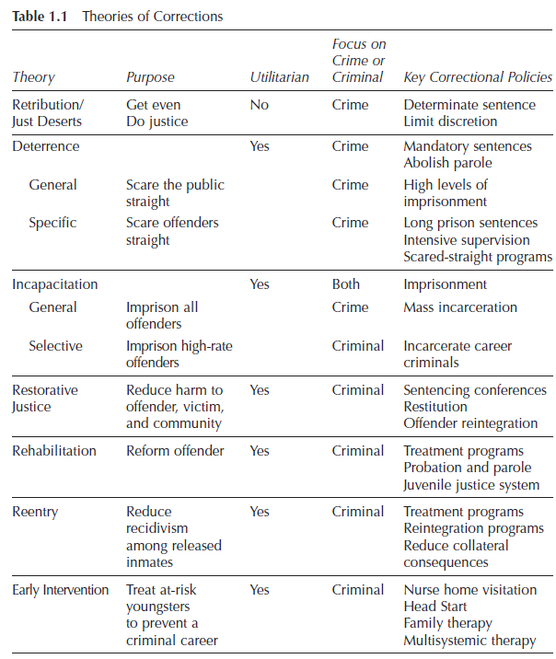
Overview of Theories of Corrections

Slide 31
Utility, Opinion, and Evidence
We live in a society that values justice
We expect offenders to be punished at a level that is consistent with the seriousness of their crime
An offender’s punishment must fall within acceptable lower limits (it cannot be too lenient) and acceptable upper limits (it cannot be too harsh)
Our correctional system is expected to balance these competing expectations: to do justice and to be utilitarian—that is, to exact retribution and to work to reduce crime
With the exception of retribution or just deserts, all other correctional theories embrace utility
Utilitarian goals only “make sense” if they have utility or benefits
A person’s “opinion” is irrelevant
Determining whether a correctional philosophy has its intended utility— whether it “works”—is not a matter of opinion but of scientific evidence—of research findings

Slide 32
Evidence-Based Corrections
Around the year 2000, a general movement was initiated to make criminal justice evidence-based
Lawrence Sherman (1998) was the first to use the term explicitly in this policy domain when he called for an evidence-based policing
Shortly thereafter, Cullen and Paul Gendreau (2000) and Doris MacKenzie (2000, 2006) set forth the case for evidence-based corrections
There was an emerging recognition in the United States and beyond that we had done a poor job of using the research we produced to help us make the best decisions possible—especially as these decisions impacted other people’s lives
Some areas embraced scientific data (e.g., medicine)
In others, such as criminal justice and baseball, the use of research was vigorously resisted and dismissed

Slide 33
Evidence-Based Corrections: Correctional Quackery
In corrections, we often make decisions on the lives of offenders—which have implications for others, including future victims—based on myth, tradition, politics, convenience, personal opinion, and personal experience
Correctional policy makers and practitioners (as well as those working in other agencies in the criminal justice system) have a professional responsibility to seek out research evidence and to use this evidence to inform their decisions
Correctional Quackery:
Defined as “interventions that are based on neither (1) existing knowledge of the causes of crime nor (2) existing knowledge of what programs have been shown correctional to change offender behavior. . . . The hallmark of quackery is thus ignorance (Latessa et al., 2002, p. 43)

Slide 34
Evidence-Based Corrections: Insider and Outsider Knowledge
There are two kinds of knowledge (Merton, 1972)
Insider knowledge refers to knowing about something because of all the personal experience an individual has had as an “insider”—, for example, someone who has worked in a correctional agency or as a police officer
Has a place in making decisions on the job and sometimes it is the only knowledge available
Outsider knowledge refers to knowing about something because one applies a standard methodology—the scientific method—to determine what is “really true” in the world
“Outsiders” do not work in an agency but rather conduct studies to develop a body of research literature on the subject
Faith is placed in “what the data say”
Outsider or scientific knowledge that counts as “evidence” here
Ignoring research evidence has not produced much success

Slide 35
Evidence-Based Corrections: Insider and Outsider Knowledge
Three problems typically are associated with “insider knowledge”
The N-of-1 problem (issue of generalizability)
Relying on personal experience—insider knowledge—means that you assume that what you have experienced also holds for other people in other settings
Basing policy on your experiences may result in decisions that would not work for other people and in other places
The conflicting-personal-experience problem
What happens when the “knowledge” you draw from your personal experiences differs from the “knowledge” someone else draws from his or her personal experiences?
The selectivity-of-perceptions problem
In deciding what is true about your world, you do not have to record or take down every instance in which some practice is tried
We may focus on the events that seem important to us—the successes or failures we have had—but ignore other events that were not as important (or pleasing) to us

Slide 36
Evidence-Based Corrections: Evidence-Based Baseball
There’s a relationship between corrections and baseball?!
Michael Lewis’s (2003), Moneyball: The Art of Winning an Unfair Game
Moneyball tells what happens when insiders who use insider knowledge run a baseball franchise as opposed to making decisions based on statistics or data—that is, decisions about who to draft, who to sign in free agency, and how to manage a game
Most general managers, managers, coaches, and scouts were, and still are, people who at one time or another played the game
It turned out that most of this insider wisdom is also wrong or true only under some circumstances
Decisions based on insider “gut feelings” rooted in personal “experience”—ignoring the evidence—were losing teams games and nobody realized it

Slide 37
Evidence-Based Corrections: Evidence-Based Baseball
Insider perspectives also typically shaped who was drafted by major league teams
Teams have scouting departments because they believe that scouts—most of them having played in the major or minor leagues—can eyeball a player and tell who is likely to make it to the majors
Once again, this usually turns out to be an incorrect assumption
Their job is not to read statistics but to use their “experience” to pick out the guy who will become a star
They can “tell” based on a “major league body”—someone who is tall and rangy, who can run fast, or who can throw over 90mph

Slide 38
Evidence-Based Corrections: Evidence-Based Baseball
Billy Beane bought into a theory about baseball—in essence, the “theory of outs”
Anything that contributes to an “out” being made is bad for the offense and good for the defense because it limits the ability to score runs—and scoring runs is how baseball games are won!
Beane was not the first person to argue that statistics should be used to make baseball decisions (Schwarz, 2004)
Was innovative in that he was the first GM to use statistics systematically to control how he managed the Oakland A’s
He provided a test case for whether evidence-based baseball is more effective than insider-based baseball and showed the value of an evidence-based approach
From 1999 to 2006, Beane’s teams averaged 94 wins a season. By contrast, the New York Yankees averaged just 97 wins annually

Slide 39
Evidence-Based Corrections: Evidence-Based Baseball
In short, the story of Billy Beane and the Oakland A’s is a case study of what happens when decisions are based on scientific evidence and when those you are competing against base their decisions on custom and personal experience
Rationality produces distinct advantages
The connection between evidence-based baseball and evidence-based corrections
It is one thing to predict how many runs a team will score and quite another to predict the recidivism rate for a treatment program
But the broader point is worth truly contemplating: In human endeavors— whether it is baseball, medicine, or corrections—ignorance is a dangerous thing

Slide 40
Conclusion
Corrections is serious business
People’s lives are at stake—both offenders and potential victims
It also is a political institution—an arm of the state
It is vulnerable to being caught up in larger socio-political movements that change the social context and thus usher in new ways of thinking and new ways of doing

Slide 41
Conclusion
Starting in the next chapter, majors shifts in corrections are described
In the late 1960s into the mid-1970s when rehabilitation came under attack and lost its status as the dominant theory of corrections
As rehabilitation declined, other theories gained in popularity and increasingly guided correctional policy and practice
Over the book’s chapters, we thus tell this story of the struggle between two visions of corrections—one rooted in pain and prisons and the other rooted in betterment and social welfare

